Slide 1


MRS. MEDHHA BHOSALE
Managing Director & Principal Architect
GROUP ARCHITECTS
DESIGN & BUILD…
ARCHITECTS INTERIOR DESIGNERS PROJECT MANAGERS

Slide 2

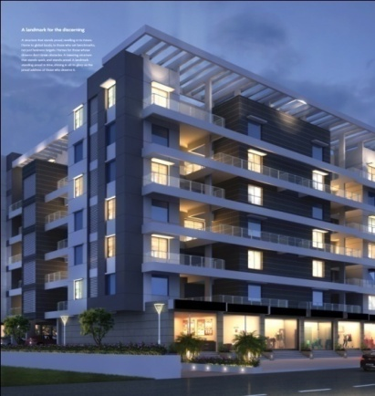
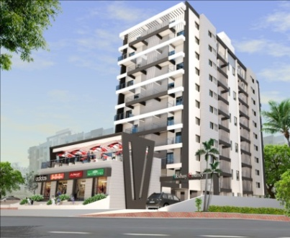
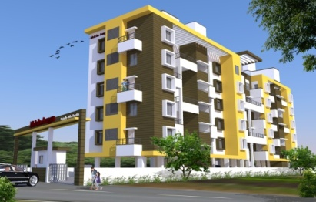
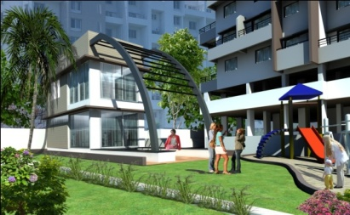
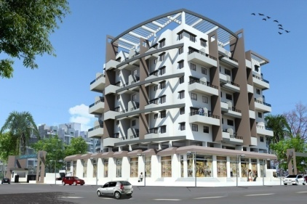
GROUP ARCHITECTS
(Architects, Interiors & Project Manager) SINCE 2003…
Why Group
We introduce ourselves as a Group Architects , a group of dynamic ,enthusiastic and experienced architects with Fresh Ideas willing to experiment contemporary architectural design solutions , actively involved in the field of Architecture and Interior since 2003 .
The biggest challenge in this industry is to exceed Client’s Expectations & deliver Perfection each & every time.
We believe in working as a family trying to achieve the ultimate and monumental goal we have set for ourselves.
Building Technologies
Client’s Needs
Client’s Budget
A ‘Total Solution’ organization :
Diversified Portfolio
Excellent quality control
EXECUTION
Planning Services
ARCHITECTURE &
INTERIOR DESIGNS
Project Management
Diversified Design
Aesthetics

Slide 3
GROUP ARCHITECTS
Practice Principles
Group Architects is a multidisciplinary design firm owned by
Managing Director & Principal Architect & Designer Ar. Medhha Bhosale (CA /2001 / 28402)
Team Structure / Road to Success by
We have a strong & experienced core team of Architects, interior designers, engineers and technicians, who play a major role in design assistance and project co-ordination .
A separate team of techno-commercial associates handle site supervision, project cost and quality control.
Client service
Our design evolves out of diverse thought processes that encompass client’s needs, budget, building technologies and aesthetics. Each project poses new challenges for us and brings forth new concept . That engages the senses of the user and observer
The scope includes guiding the client’s for developing the project brief, site evaluation, space planning / development / volumetric study and appointment of consultants for directing the entire design and documentation , Selection of materials Periodic inspection and evaluation of works at site.
Design Work Progress
Our working method provides design alternatives, often in 3 dimensional forms for each design solution. The advantages and disadvantages for each option are openly discussed with clients at regularly scheduled design reviews. Our recommendations are regularly submitted to the client and continually evaluated according to the criteria established by the programme, project schedule , cost plan and quality objectives of the project. This method ensures that the project continually progress forward eliminating delays in project completion and ultimately reducing project costs . We believe in a fully integrated approach towards architecture. The end user’s requirements must be considered to ensure the achievement of the client’s goal.
Design & Build…

Slide 4
GROUP ARCHITECTS
DESIGN STAGES…
1. Concept Design
• Site Evaluation And Analysis Report With Activity Distribution
• Space Planning / Programme Requirements In Relation To Activities And Site Potential.
• Prepare Conceptual Design Alternatives With Explanatory Sketches
2. Preliminary Design / Design Development
• Modification the conceptual designs incorporating required changes, prepare the preliminary drawings, along with the preliminary estimate of cost on area basis.
• Coordination With Specialist Consultants And All Disciplines For Building Project
3. Documentation & Drawings
Design & Build…
• Drawings For Client's /Statutory Approval
• Working Drawings And Tender Documents
• Appointment Of Contractors
4. Construction
• Prepare and issue working drawings and details for proper execution of works during construction.
• Approve samples of various elements and components.
• Check and approve shop drawings submitted by the contractor/ vendors.
• Periodic inspection and site supervision order to ensure that the work at site proceeds in accordance with the contract documents
• Issue Certificate of Virtual Completion of works.
• Prepare and submit completion reports and drawings for the project as required and assist the Client in obtaining "Completion/ Occupancy Certificate" from statutory authorities, wherever required.

Slide 5
GROUP ARCHITECTS
AREAS OF WORK…
Architectural Projects
Architecture has to do with planning, designing and constructing spaces that reflect functional, technical, social, environmental and aesthetical considerations. It requires creative manipulation and coordination of material, technology, light and shadow. With our requisite and experienced resources, we achieve quality standards in every project we take.
Residential Projects
Lifestyles are changing around the world. Rapidly expanding & changing technologies, values, cultures and economies are influencing how we live and ultimately, the spaces we live in. We design environments that complement the ever changing ways the world adapts. While each residence is unique in terms of location, density and character, they all share a common thread. Each design is structured with an appropriate interpretation of the occupant’s culture and lifestyle.
Bungalow
Multi residential
Hospitality & Healthcare
In recent years, there has been a shift in the use of hotels that cater to a growing variety of functions. Suffice it to say, hotels have become destinations by themselves. Every space in hospitality interiors is now designed with a different strategy to accommodate the needs of every guest. With expanding businesses, travel and tourism, there is a growing need for designing hospitality spaces in the most attractive and creative manner, which creates a dream home away from home for its clients.
The health care industry is going through a metamorphosis of sorts, wherein the old look is being replaced by fresh and warm decor, which spells comfort and positivity. We aim to facilitate this change in the healthcare industry- in order to revolutionize its designs, and speak character and charm
Design & Build…
Corporate Interiors
The arena of Corporate planning is enormously multifaceted, with varying functions and forms as per the requirements and the scale of the project. We have the requisite resources as well as technical competences to conceptualize and develop corporate projects to its logical, more disciplined and organized conclusion. This demands skills in breaking the monotony using various design techniques like forms, textures, colors, and introduction of new concepts without breaking the structural code.
Retail Architecture & Interiors
The aesthetics of stores and retail outlets have evolved to be similar to private homes, giving rise to more intimate settings in which a customer feels comforted with a feeling of a space of his own. Hence, we emphasize on creating elements that lend a persona to spaces and appear inviting to prospects.

Slide 6

GROUP ARCHITECTS
(Architects, Interiors & Project Manager) SINCE 2003…
Allied Firms:
* Group Consultants * Group Enterprises
Principal Architects & Directors:
Ar. Sachin Solanki (CA/2002/28913)
Ar. Medha Bhosale (CA/2001/28420)
A Facility Design is successful when you have Cheerful & Productive People working in an Environment which is sustainable in letter & spirit.
Core Team:
Ronak Nijampurkar (Senior Interior Designer)
Suhas Adhav (Senior Architect)
Ms. Krishna Panpaliya (Junior Architect)
Ms. Varnika Agrawal (Junior Architect)
Omprakash Trimukhe (Architectural Assistant)
Harshad Lakhe (Architectural Assistant)
Vijay Thorat ( Site Supervisor)
Atul Adsul (Site Supervisor)
Nitin Gurne (Administration & HR))
Mukund Jadhav (Finance)
15+ Years
450+ Projects
105+ Clients
Pune Office
25+ Employes

Slide 7
GROUP ARCHITECTS
ONE STOP SOLUTION – OUR SERVICES.…
MASTER PLANNING
ARCHITECTURE & INTERIOR DESIGN
STRUCTURAL ENGINEERING
MEP ( MECHANICAL, ELECTRICAL & PLUMBING)
GRAPHICS
LIASONING
COST PLANNING & CONTROL
Design & Build…
ABOUT DESIGN…
A design concept is the idea behind a design. It’s the underlying logic, thinking & reasoning for how you’ll design.
Before developing a concept, we prefers a talk to our prestigious clients & ask the questions about their brand, their customers & their goals for the particular project. We do our own research into their industry looking at competing designs & trying to understand more about their requirements.
We have team of an expertise who provides best solution in the development of design. We provide our services & our design evolves out of diverse thoughts to suit client’s needs, budgets & timescales resulting in responsive, living & working spaces.

Slide 8




















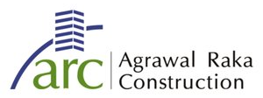






GROUP ARCHITECTS
OUR PRESTIGIOUS CLIENTS…
CORPORATE
DEVELOPERS
Design & Build…
RETAILS

Slide 9
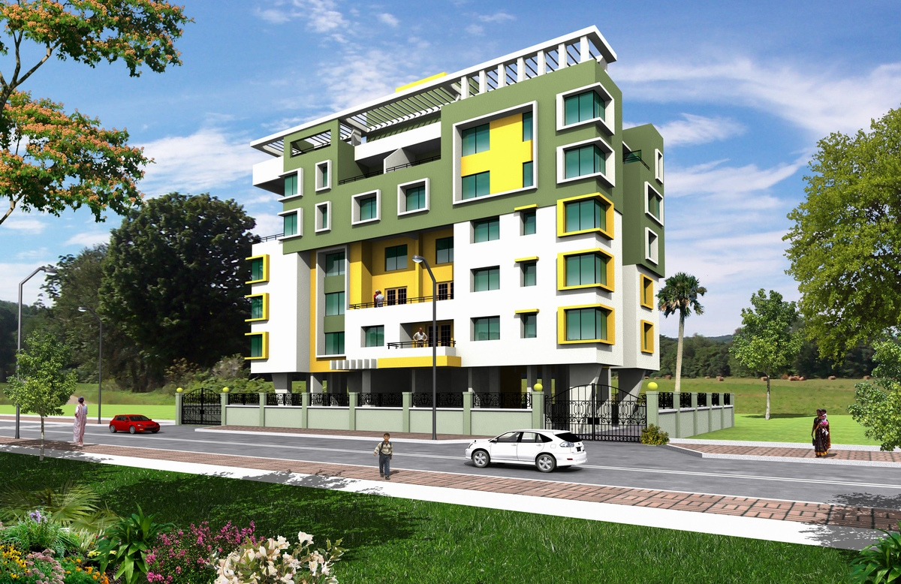
ARCHITECTURAL PROJECTS

Slide 10
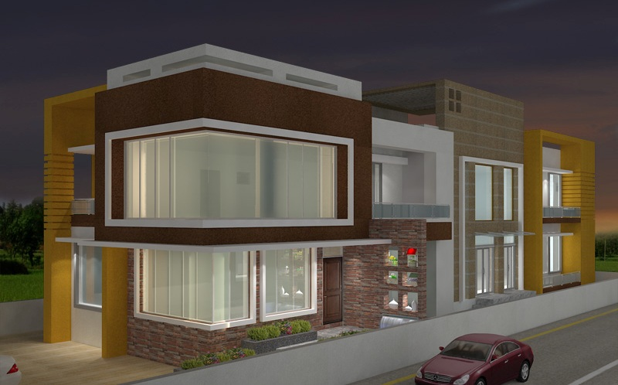
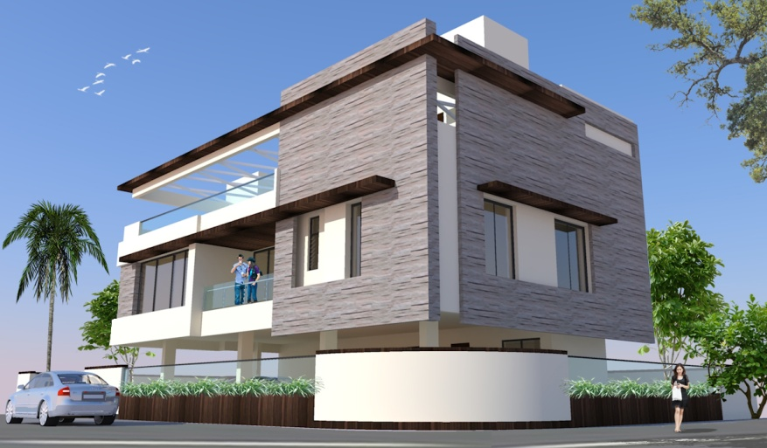
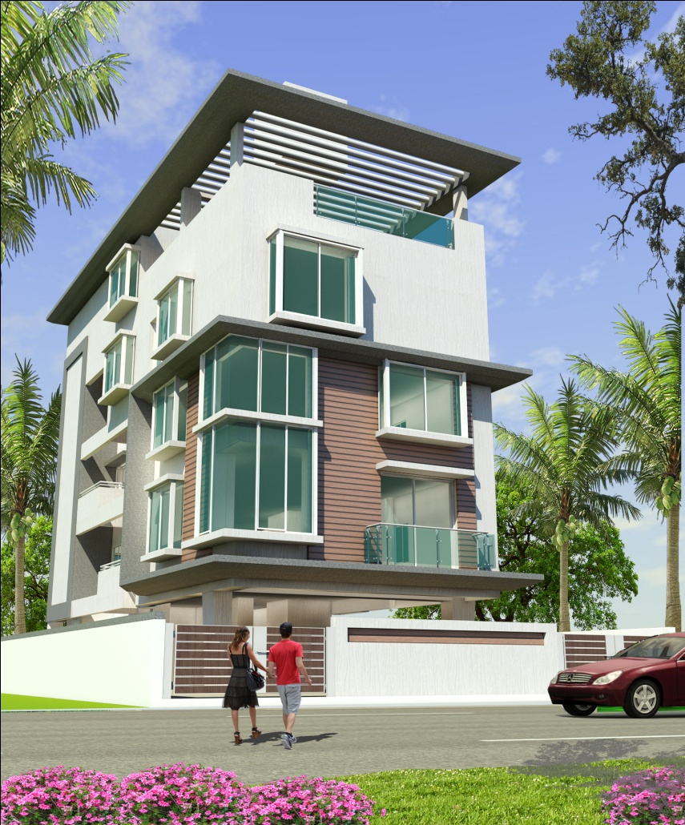
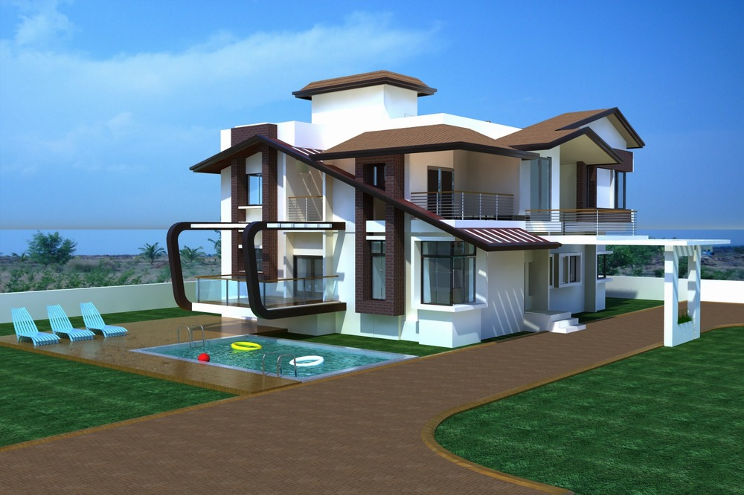
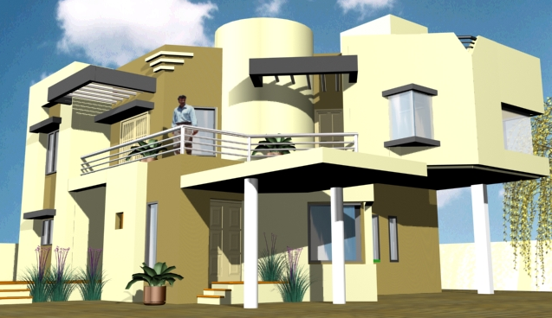
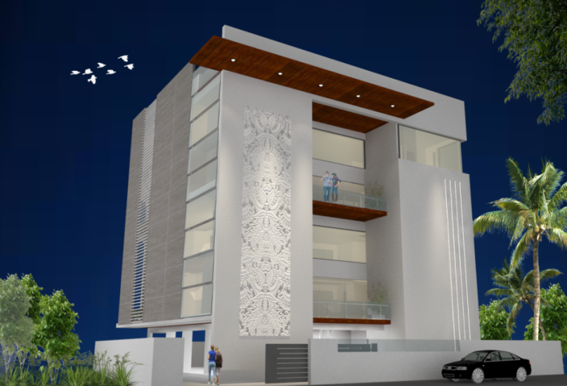
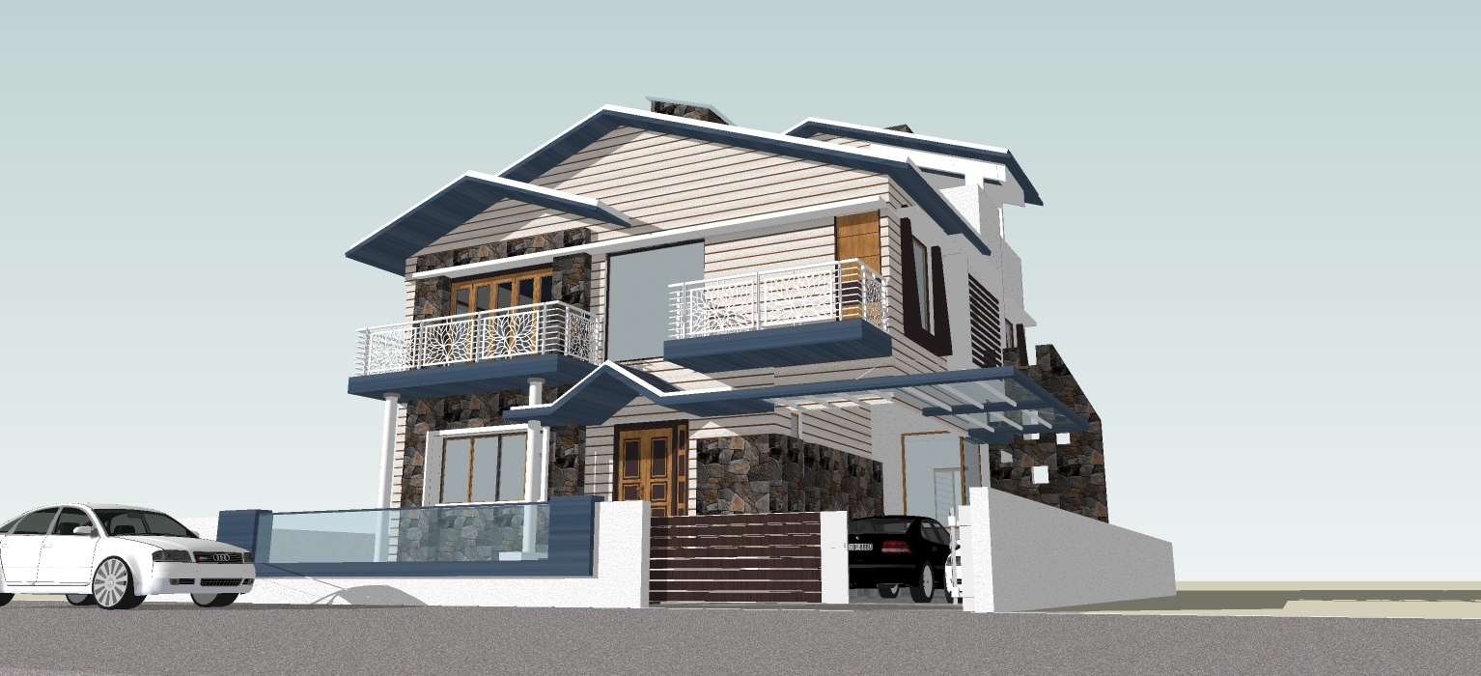
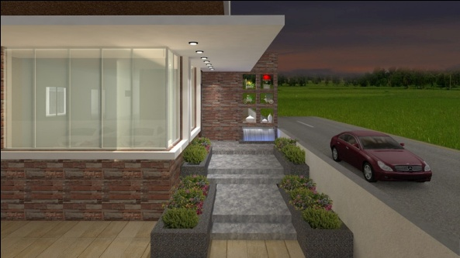
GROUP ARCHITECTS
BUNGALOWS …Area ranging from 2,500 - 30,000sq.ft

Slide 11
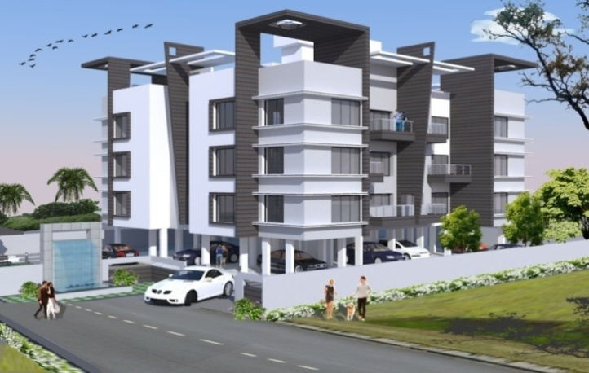
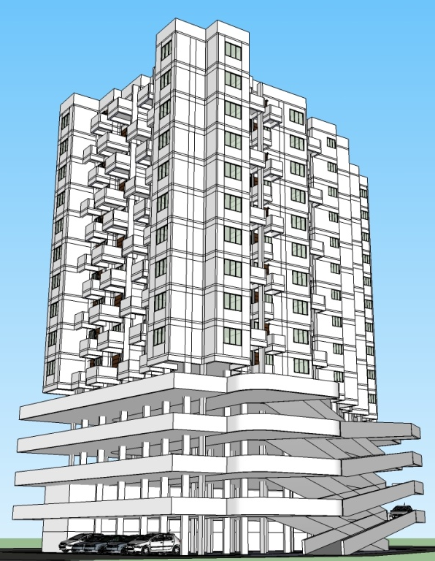
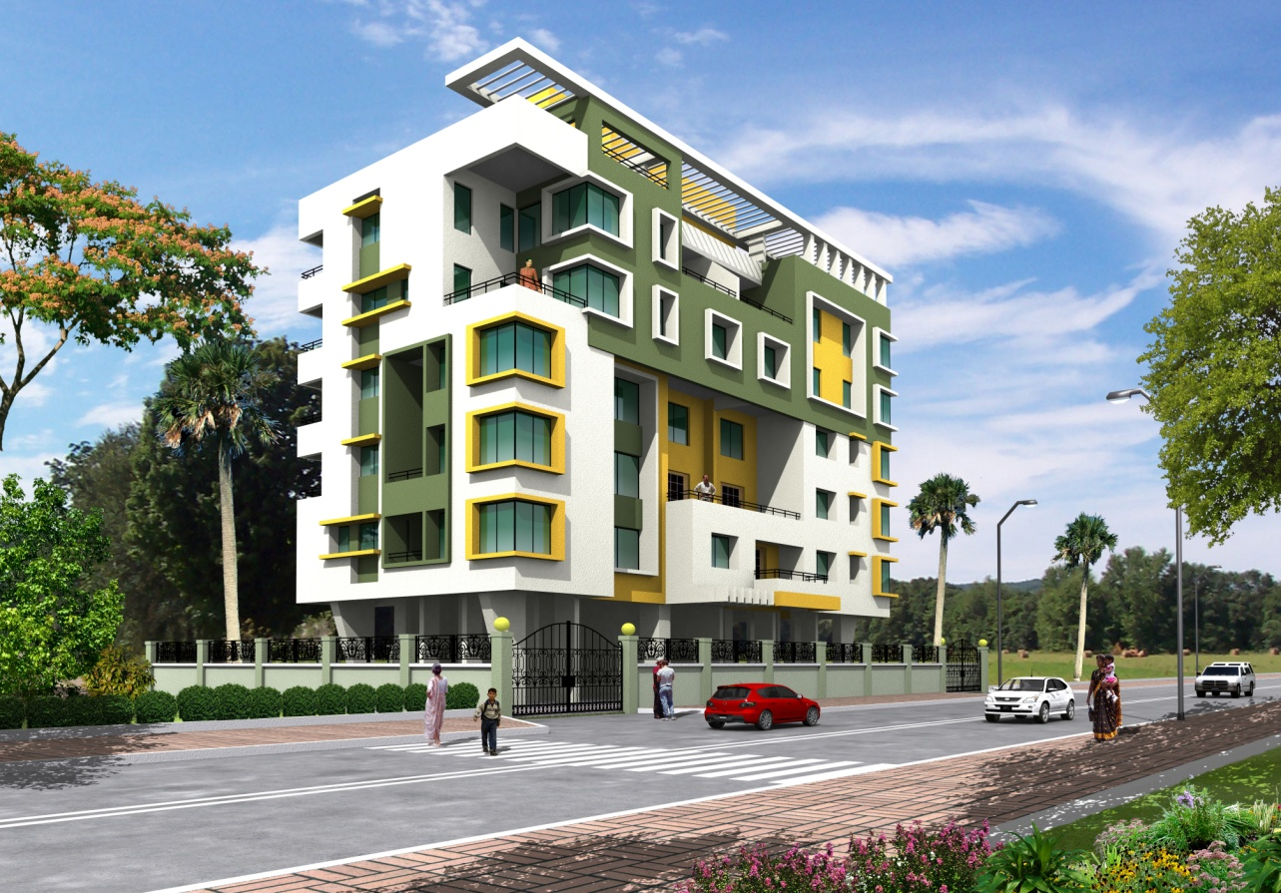
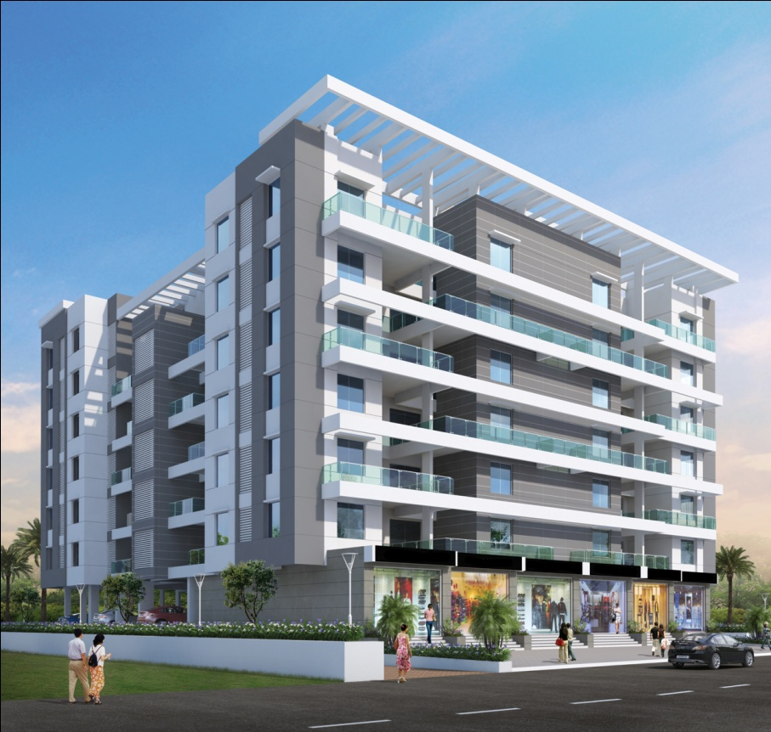
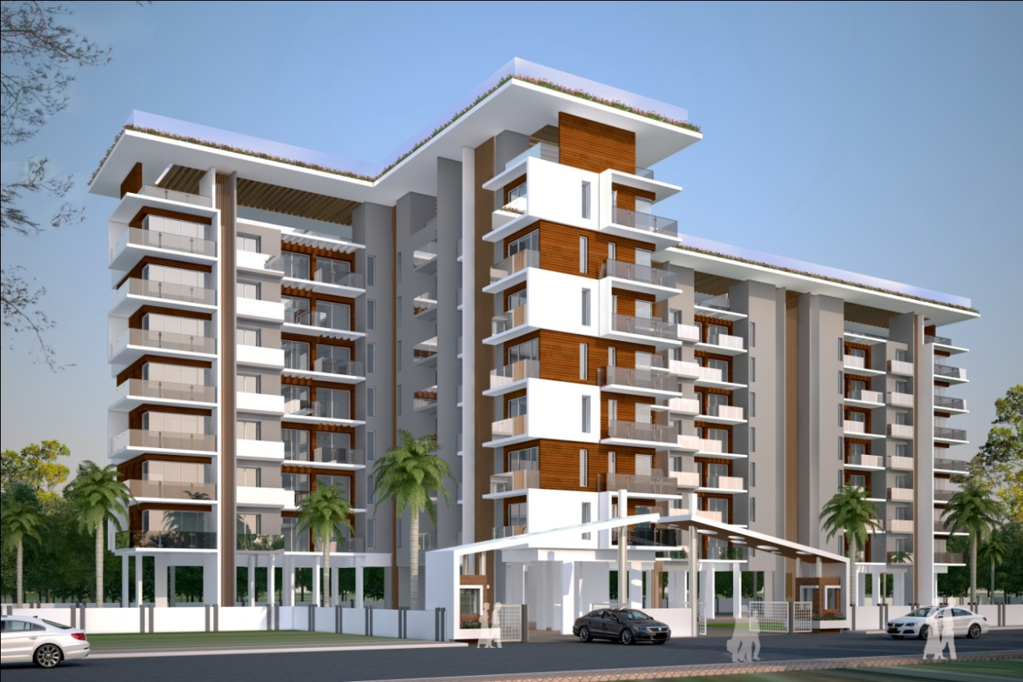
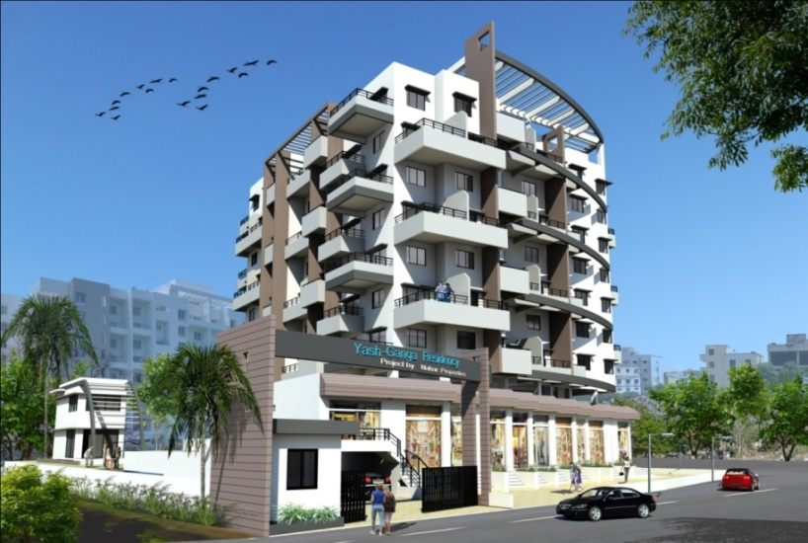
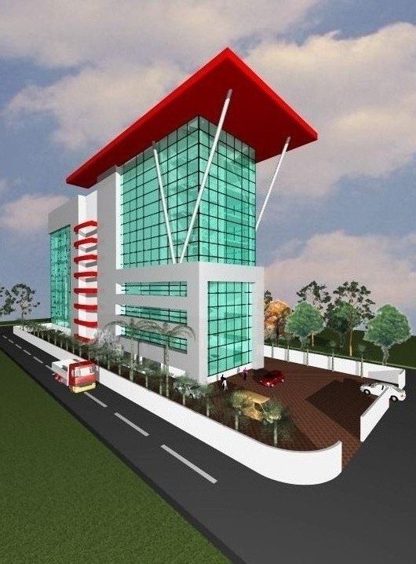
GROUP ARCHITECTS
RESIDENTIAL & COMMERCIAL BUILDINGS…Area ranging from 10,000 – 30,000 sq.ft
Entrance & Corridor Designs.…

Slide 12
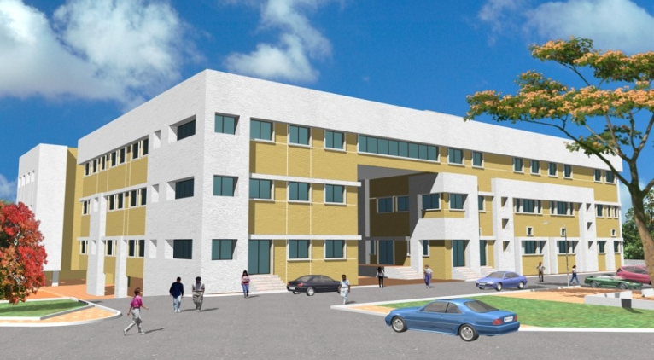
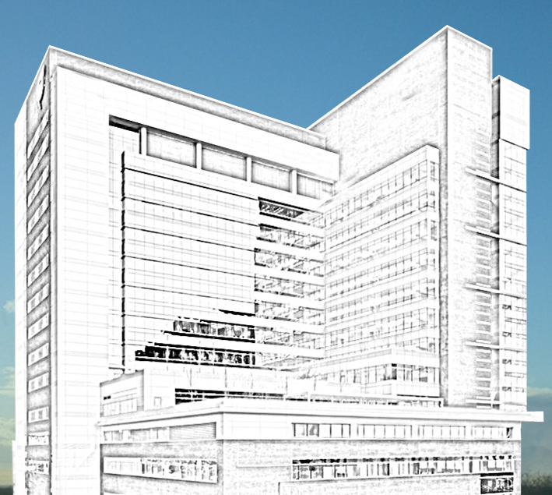
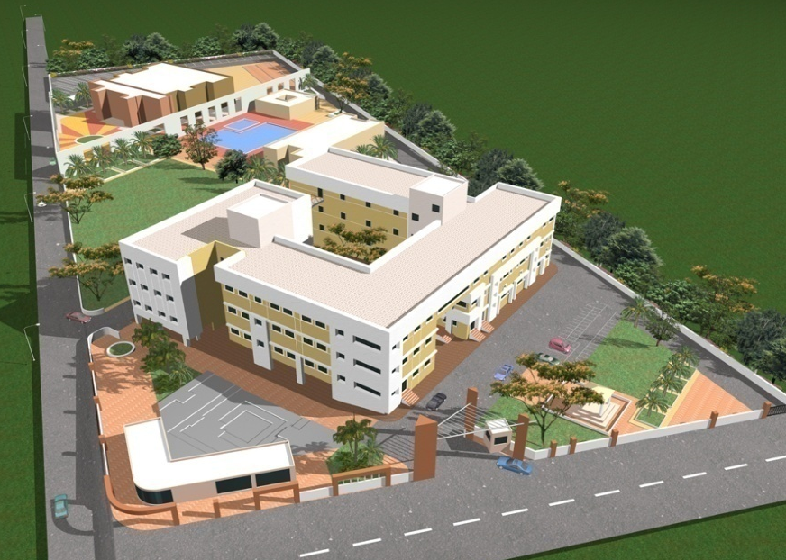
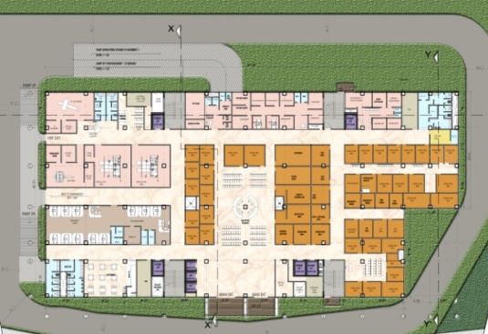
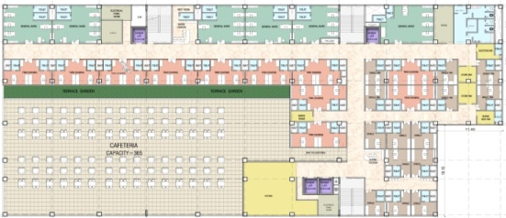
GROUP ARCHITECTS
HEALTHCARE…Area ranging from 1,25,000-3,04,500 sq.ft
Eye Hospital at Osmanabad
(Award Winning project)
Land Area = 2 Acre
Construction area = 125000.00 sq.ft
Construction cost = 15 Cr
Status = COMPLETED
Multi Speciality Hospital at Pune
(350 Bed capacity project)
Land Area = 12262.50 sqm
Construction area = 30450.00 sqm
Construction cost = 98.00 Cr.
Status = On Going

Slide 13
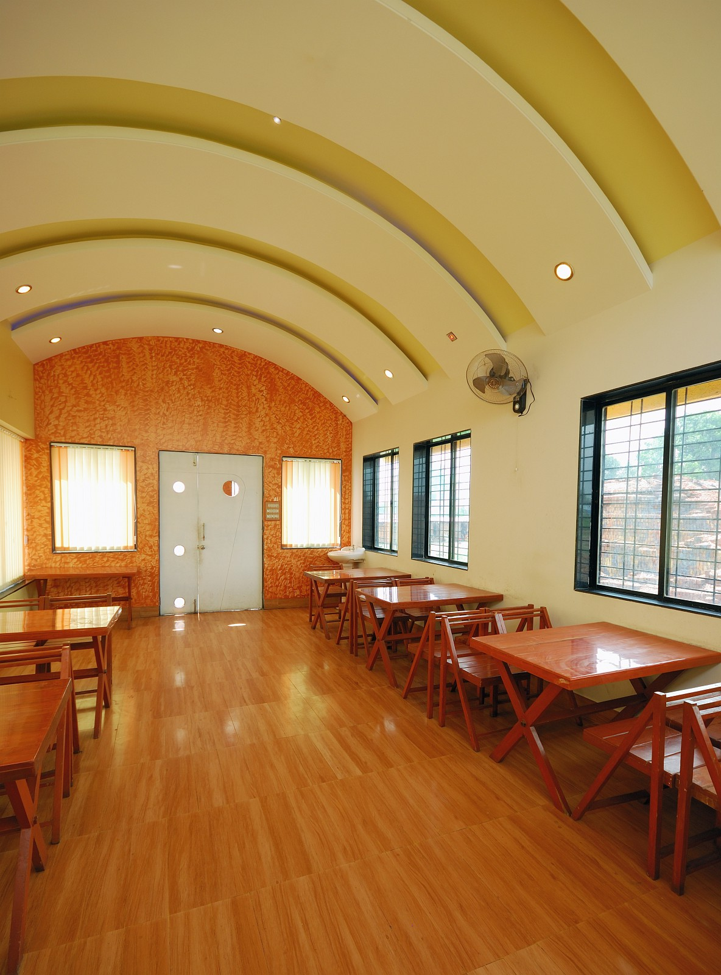
COMMERCIAL & HOSPITALITY INTERIORS

Slide 14
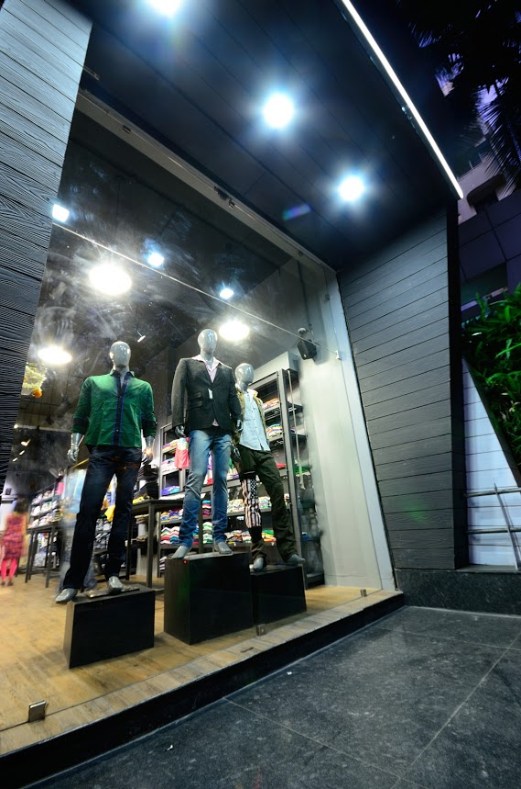
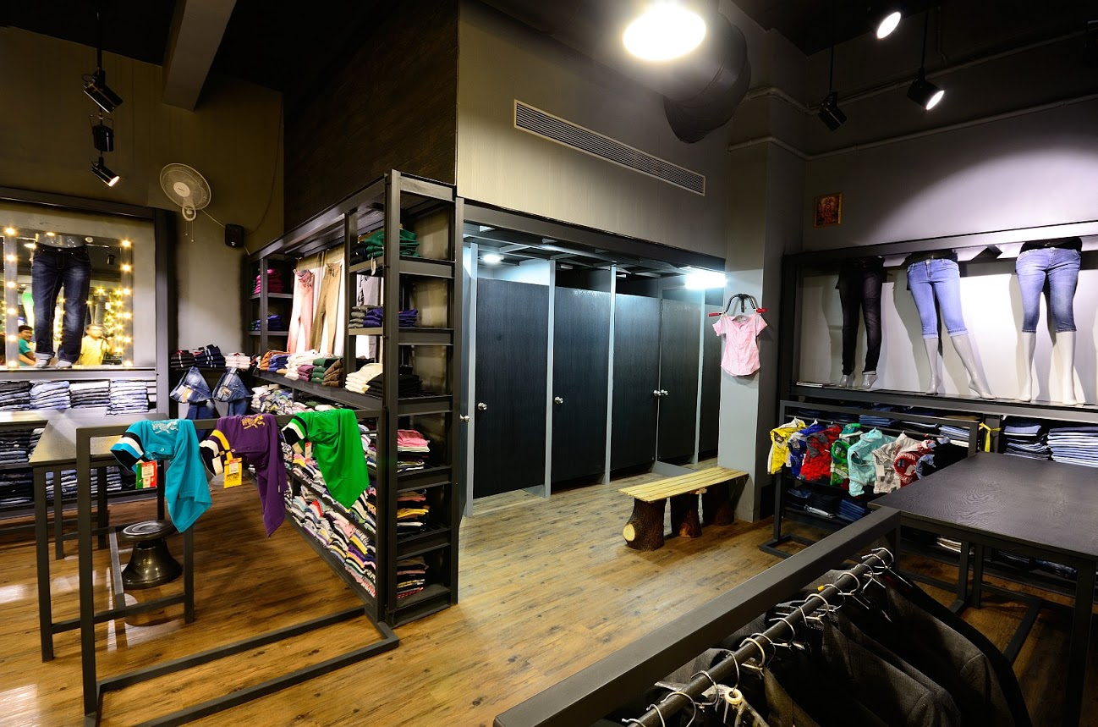

GROUP ARCHITECTS
COMMERCIAL INTERIORS…Area ranging from 2000sq.ft

Slide 15
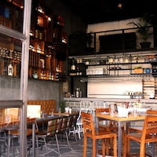
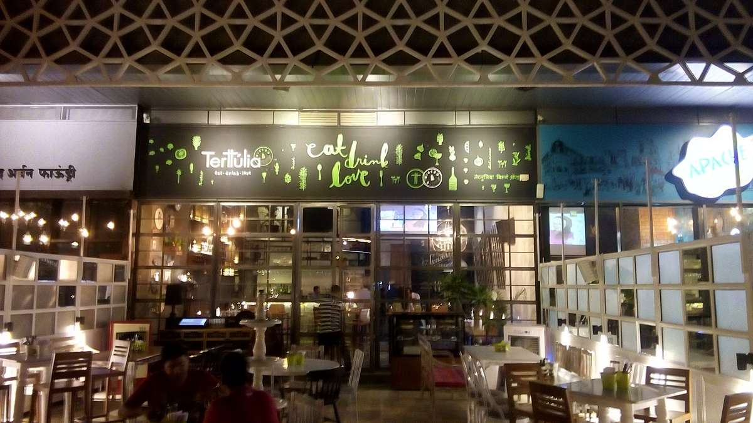
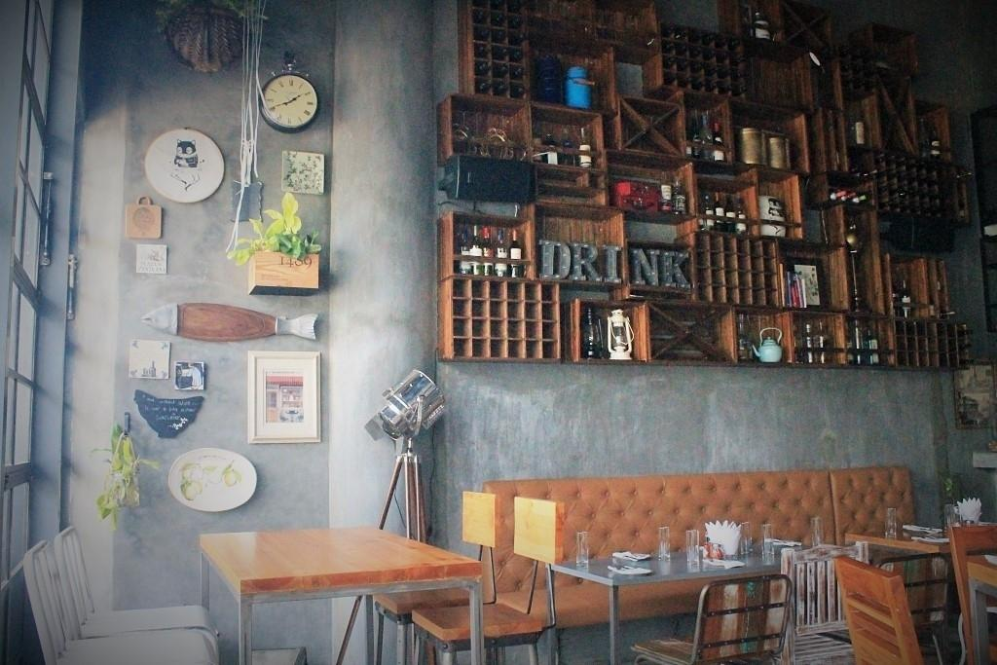
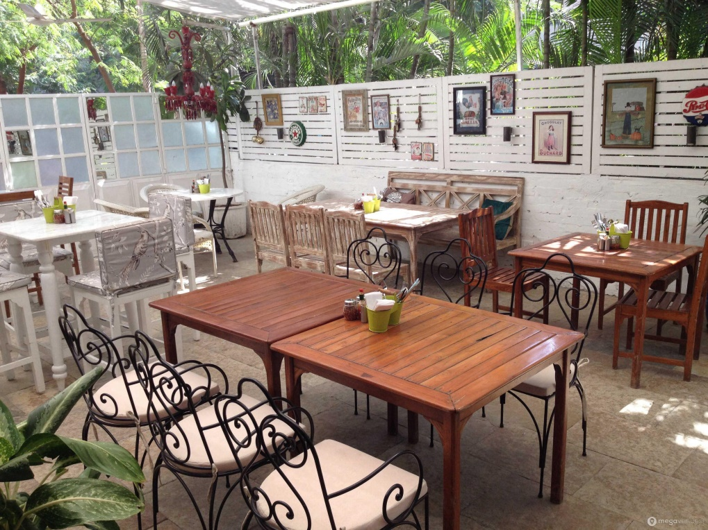
GROUP ARCHITECTS
COMMERCIAL INTERIORS…Area ranging from 2,000-5,000sq.ft

Slide 16
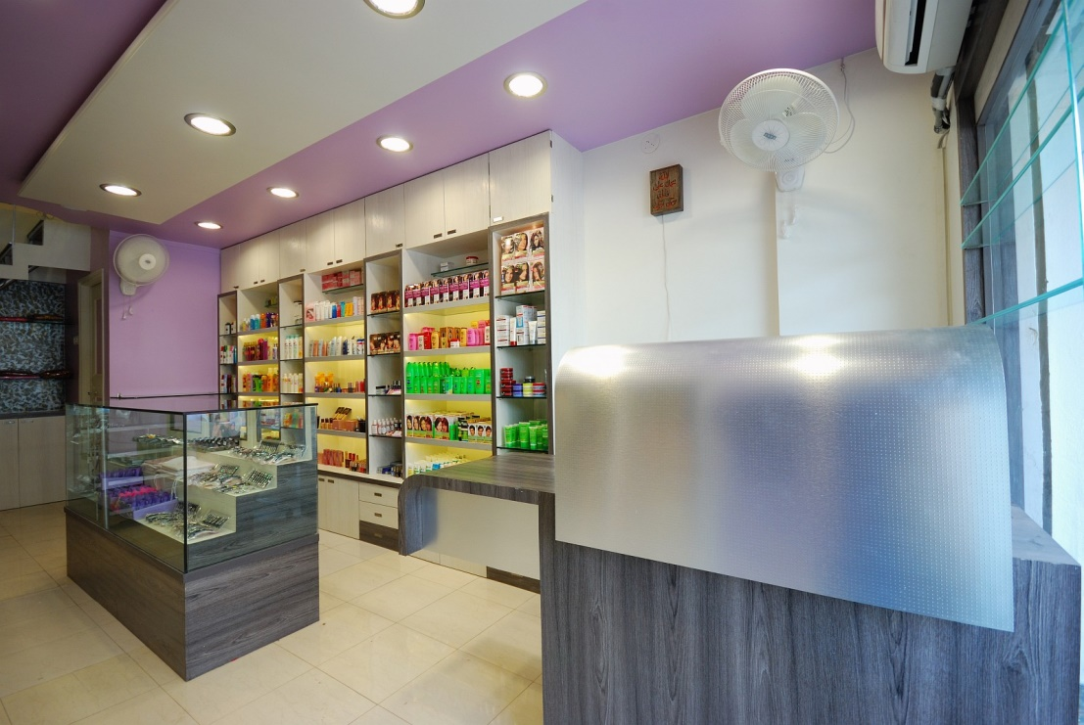
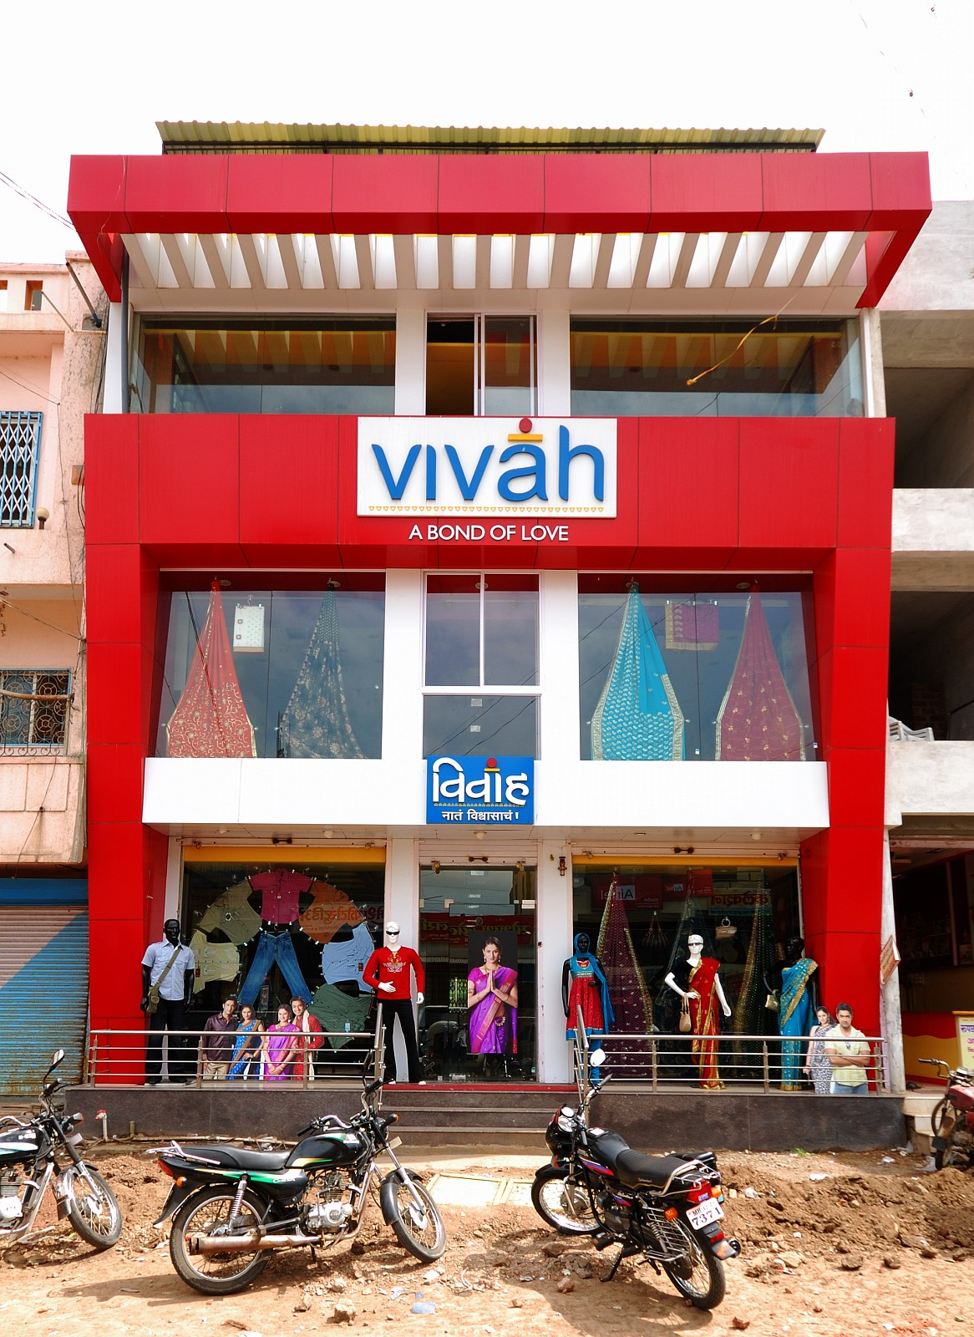
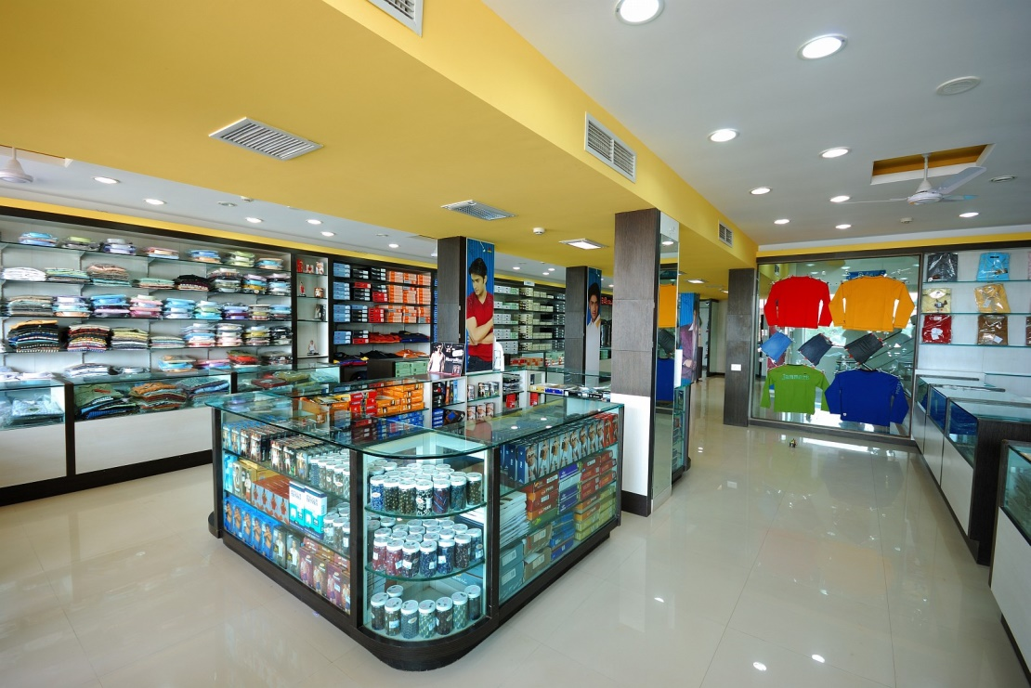
GROUP ARCHITECTS
COMMERCIAL INTERIORS…Area ranging from 2000 sq.ft

Slide 17
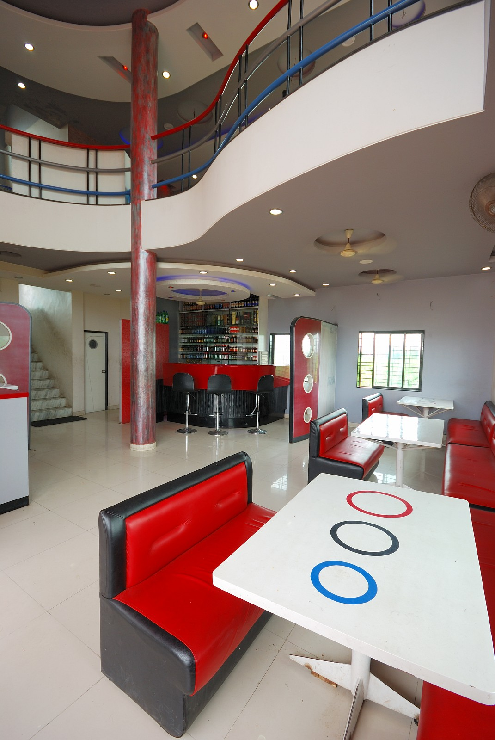
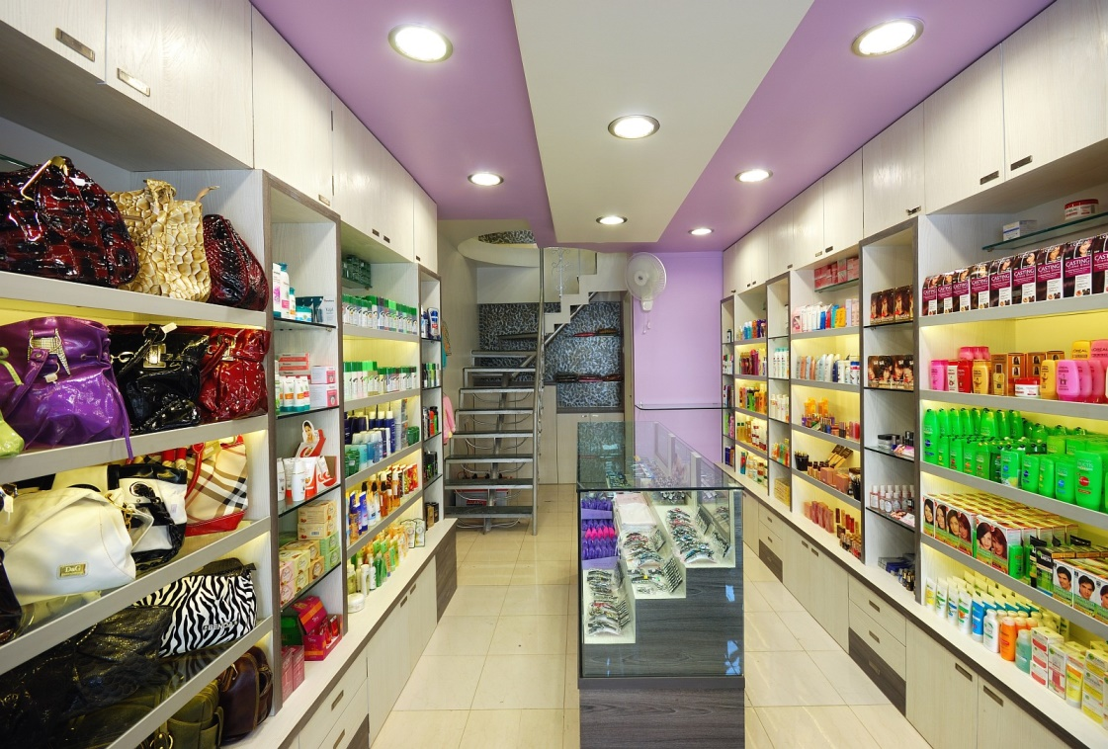
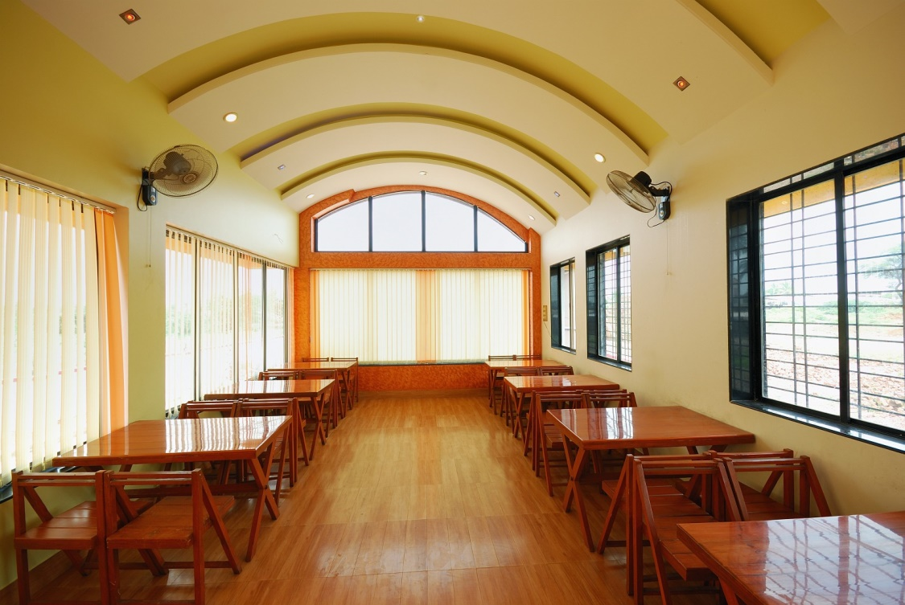
GROUP ARCHITECTS
COMMERCIAL & HOSPITALITY INTERIORS…Area ranging from 2000-5000 sq.ft

Slide 18
CORPORATE INTERIORS

Slide 19
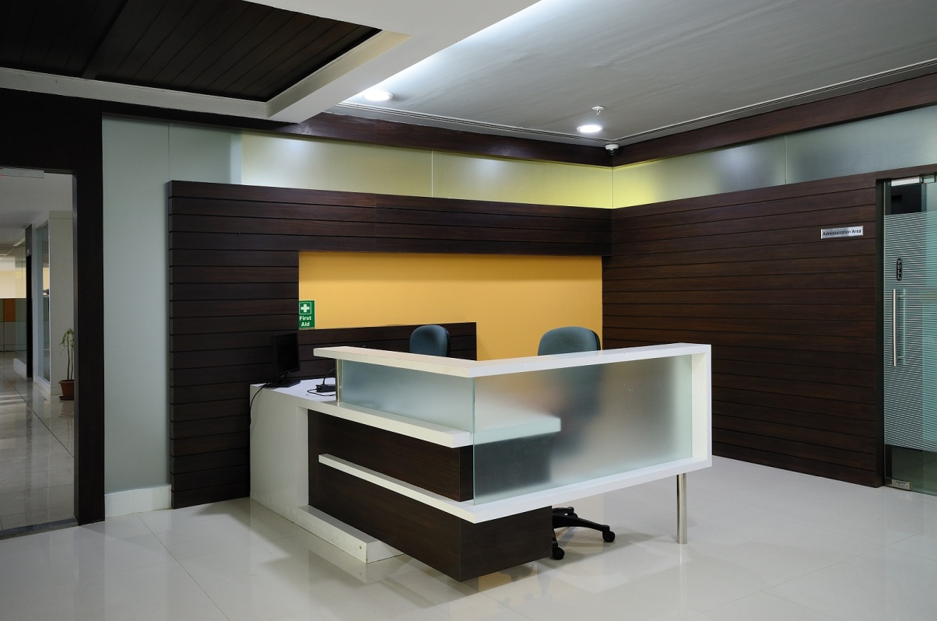
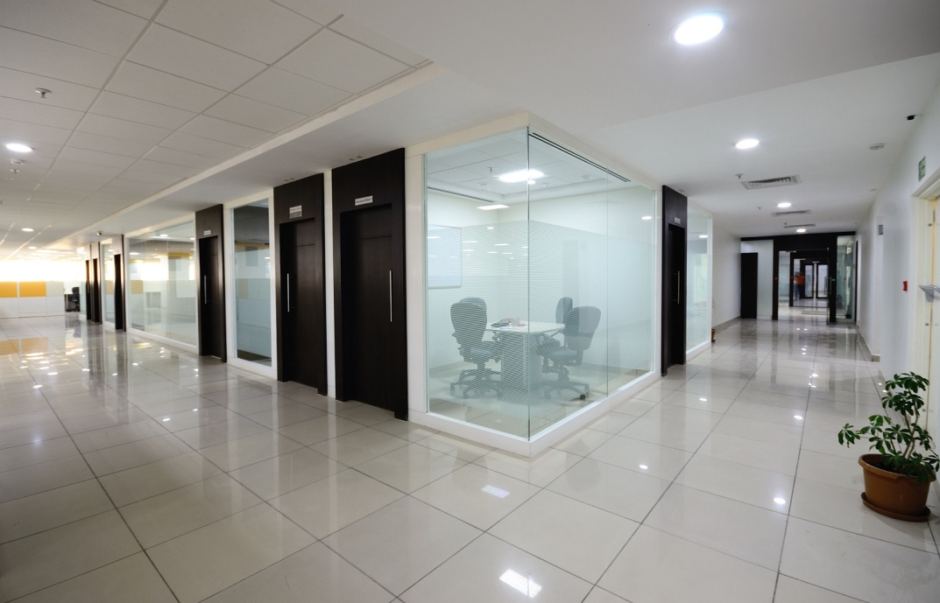
GROUP ARCHITECTS
CORPORATE INTERIORS…Area ranging from 5,000 - 80,000sq.ft
Entrance & Corridor Designs.…

Slide 20
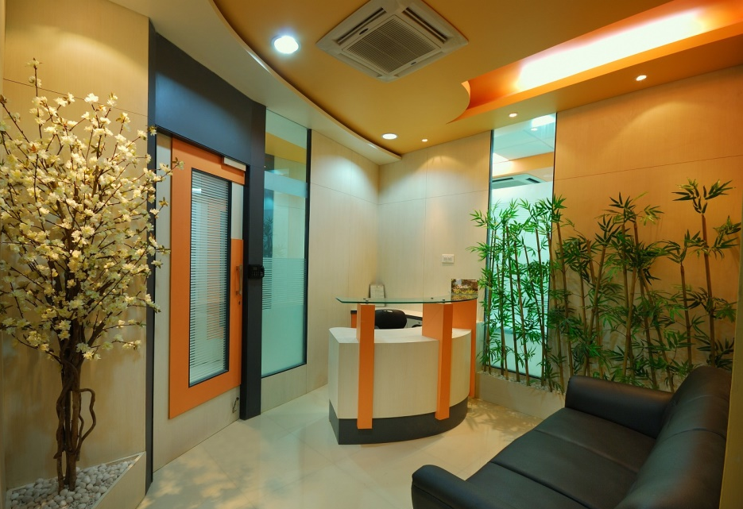
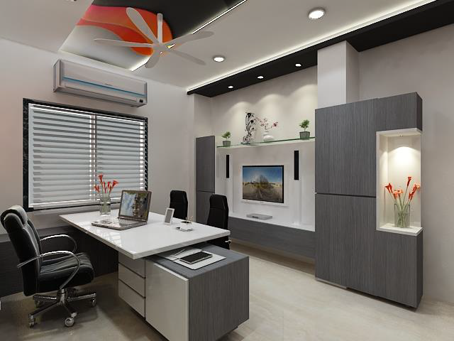
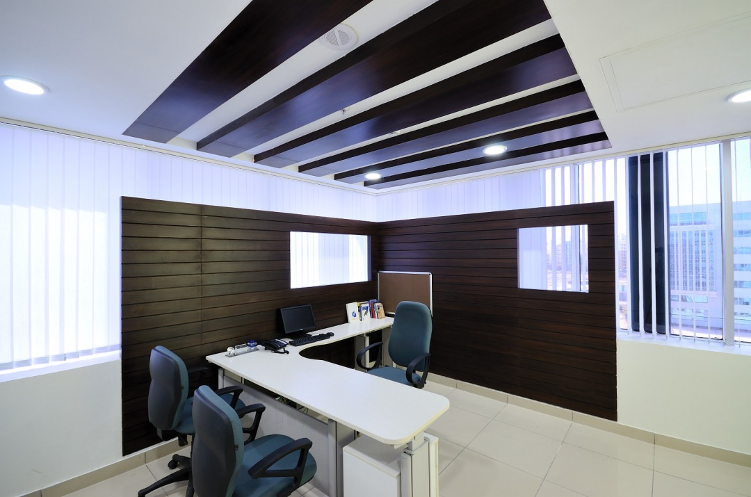
GROUP ARCHITECTS
CORPORATE INTERIORS…Area ranging from 5,000 - 80,000sq.ft
Office Cabin Design.…

Slide 21
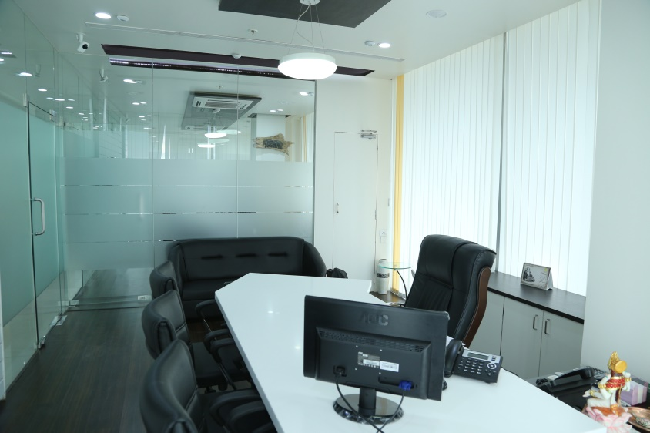
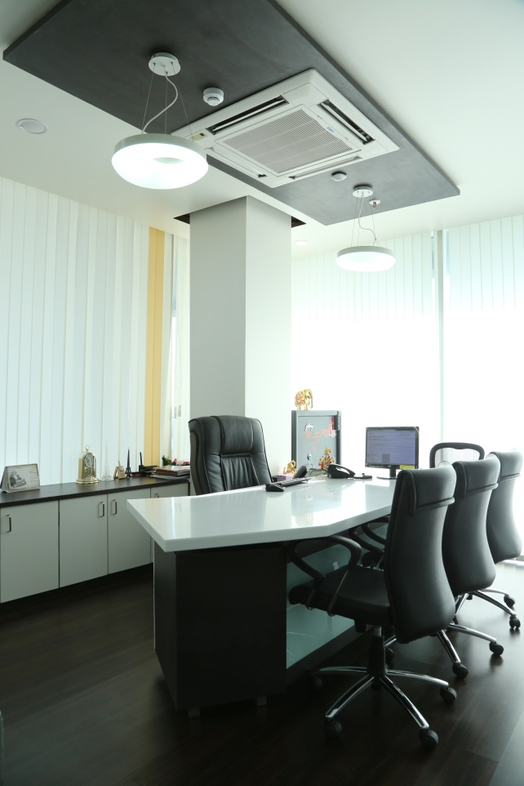
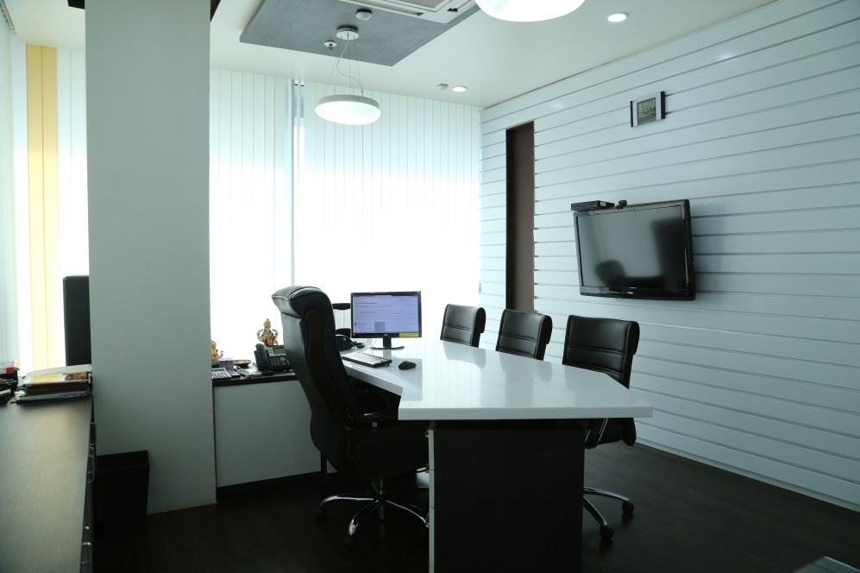
GROUP ARCHITECTS
CORPORATE INTERIORS…Area ranging from 5,000 - 80,000sq.ft
Office Cabin Design.…

Slide 22

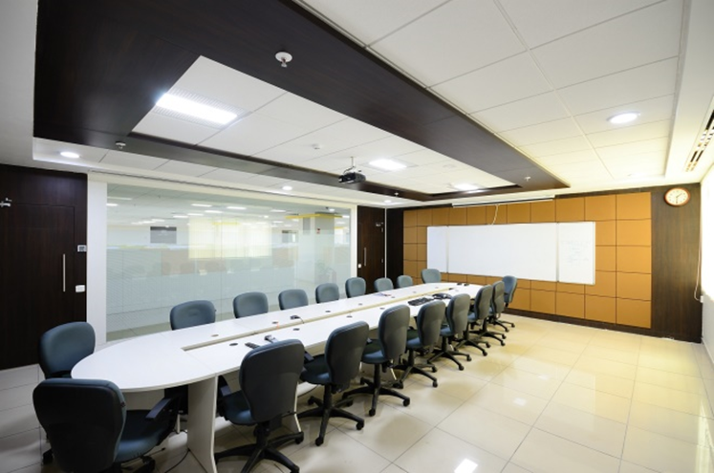
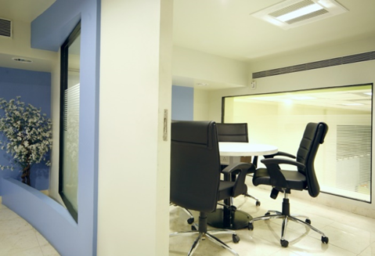
GROUP ARCHITECTS
CORPORATE INTERIORS…Area ranging from 5,000 - 80,000sq.ft
Conference Room Designs.…

Slide 23


GROUP ARCHITECTS
CORPORATE INTERIORS…Area ranging from 5,000 - 80,000sq.ft
Work Stations.…

Slide 24



GROUP ARCHITECTS
CORPORATE INTERIORS…Area ranging from 5,000 - 80,000sq.ft
Common & Recreational Space Design.…

Slide 25

RESIDENTIAL INTERIORS

Slide 26


GROUP ARCHITECTS
RESIDENTIAL INTERIORS…Area ranging from 1,200-7,500sq.ft
Entrance Space Designs…

Slide 27




GROUP ARCHITECTS
RESIDENTIAL INTERIORS…Area ranging from 1,200-7,500sq.ft
Living & Dining Spaces.…

Slide 28



GROUP ARCHITECTS
RESIDENTIAL INTERIORS…Area ranging from 1,200-7,500sq.ft
Living & Dining Spaces.…

Slide 29


GROUP ARCHITECTS
RESIDENTIAL INTERIORS…Area ranging from 1,200-7,500sq.ft
Living & Dining Spaces.…

Slide 30




GROUP ARCHITECTS
RESIDENTIAL INTERIORS…Area ranging from 1,200-7,500sq.ft
Living & Dining Spaces.…

Slide 31




GROUP ARCHITECTS
RESIDENTIAL INTERIORS…Area ranging from 1,200-7,500sq.ft
Kitchen Design.…

Slide 32



GROUP ARCHITECTS
RESIDENTIAL INTERIORS…Area ranging from 1,200-7,500sq.ft
Bedroom Design.…

Slide 33




GROUP ARCHITECTS
RESIDENTIAL INTERIORS…Area ranging from 1,200-7,500sq.ft
Bedroom Design.…

Slide 34




GROUP ARCHITECTS
RESIDENTIAL INTERIORS…Area ranging from 1,200-7,500sq.ft
Bedroom Design.…

Slide 35



GROUP ARCHITECTS
RESIDENTIAL INTERIORS…Area ranging from 1,200-7,500sq.ft
Bedroom Design.…

Slide 36




GROUP ARCHITECTS
RESIDENTIAL INTERIORS…Area ranging from 1,200-7,500sq.ft
Outdoor Spaces.…

Slide 37

GROUP ARCHITECTS
CONTACT US…
How do we like to work?
We find out exactly what you’re about & what you’re looking to achieve & then help to achieve it. We build long lasting relationships with our clients, if you want to develop your brand with just one team.. We are your right choice
GET IN TOUCH :
Group Architects
Registered Office
“ Moti Heights”, 722, Budhwar Peth,
Near Jijamata Baug,
Pune – 411002
Email : grouparchitectspune@gmail.com
Web : www.grouparchitects.in
Contact No : 9822625564, 9403662620
BRANCH OFFICE
Vaidehi Vista 102 , Deepa hsg soc.
Plot no 66&67 Baner pashan Link Road ,Pashan, Pune 411021
DESIGN & BUILD…

Slide 38
GROUP ARCHITECTS
CONTACT US…
DESIGN & BUILD…
We’d love to discuss any
Projects you have in mind.
Can’t wait to get involved, connect with us now………….!

